Slide 1

MAJor Evaluation Project
(AI FOR GAMES AND APG)
Gauraang Goel 21CSU319
Karlheinz asylum

Slide 2
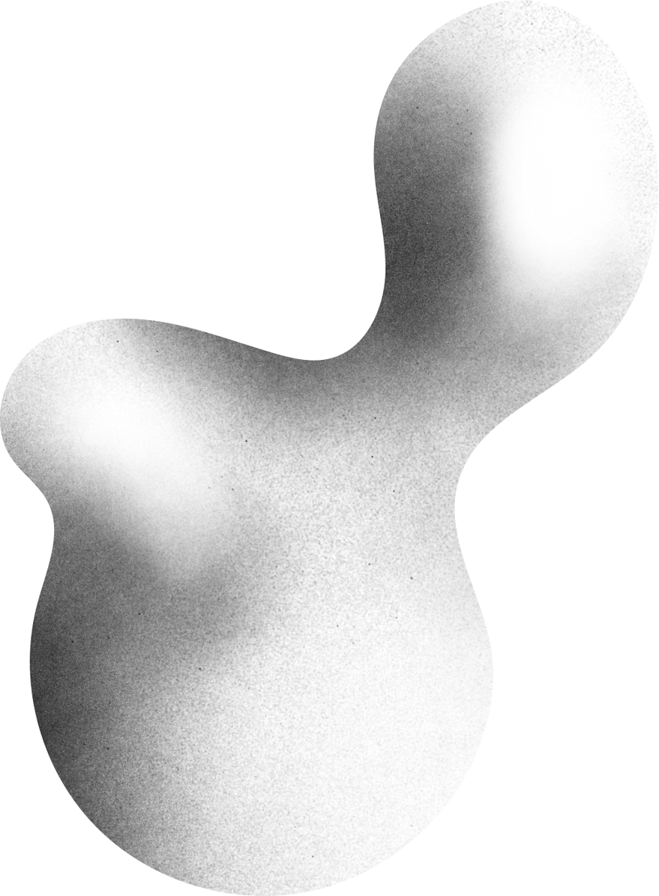
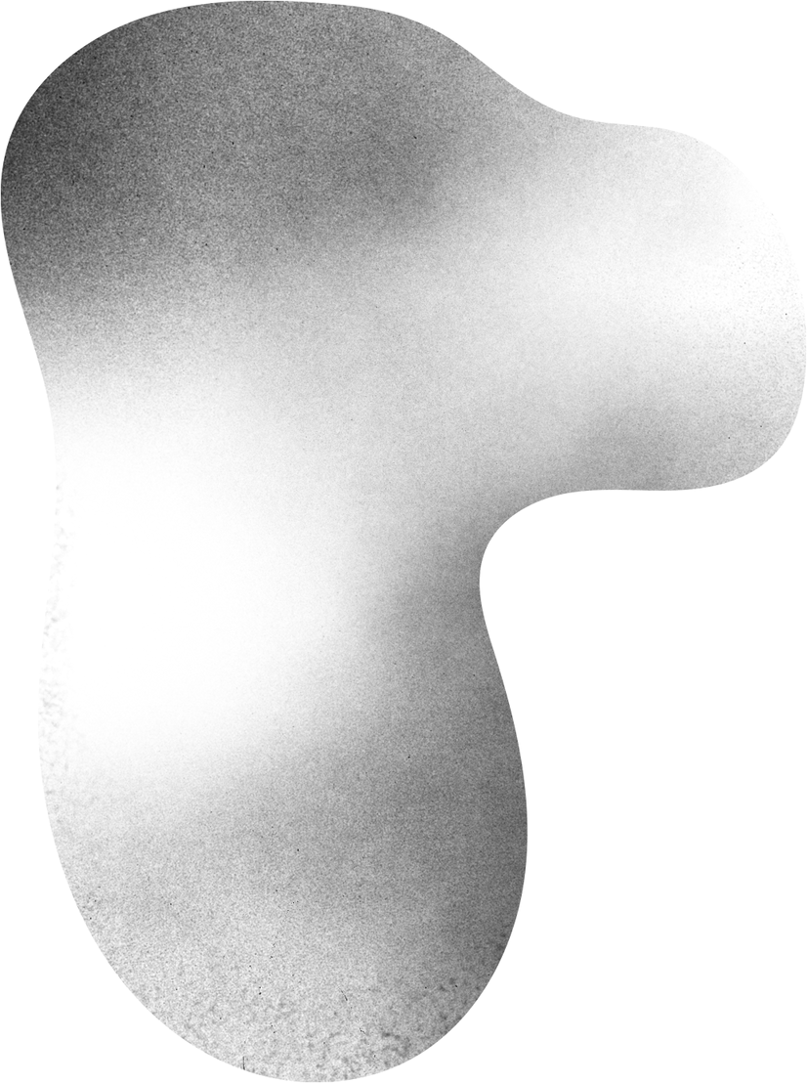
Table Of Content
01
ABOUT THE GAME
05
STATE MACHINE CHART
09
PROMBLEM FACED
02
OBJECTIVES
06
IN GAME SCREENSHOTS
03
SCRIPTS CREATED
07
ASSET USED
04
FEATURES
08
REFERNCES

Slide 3

"Welcome to the eerie world of 'Karlheinz Asylum,' a spine-chilling video game set within the confines of a long-abandoned mental asylum. As a survivor trapped in this nightmarish setting, your mission is to outwit hordes of relentless zombies and unravel the asylum's dark secrets to escape with your sanity intact."
ABOUT THE GAME

Slide 4

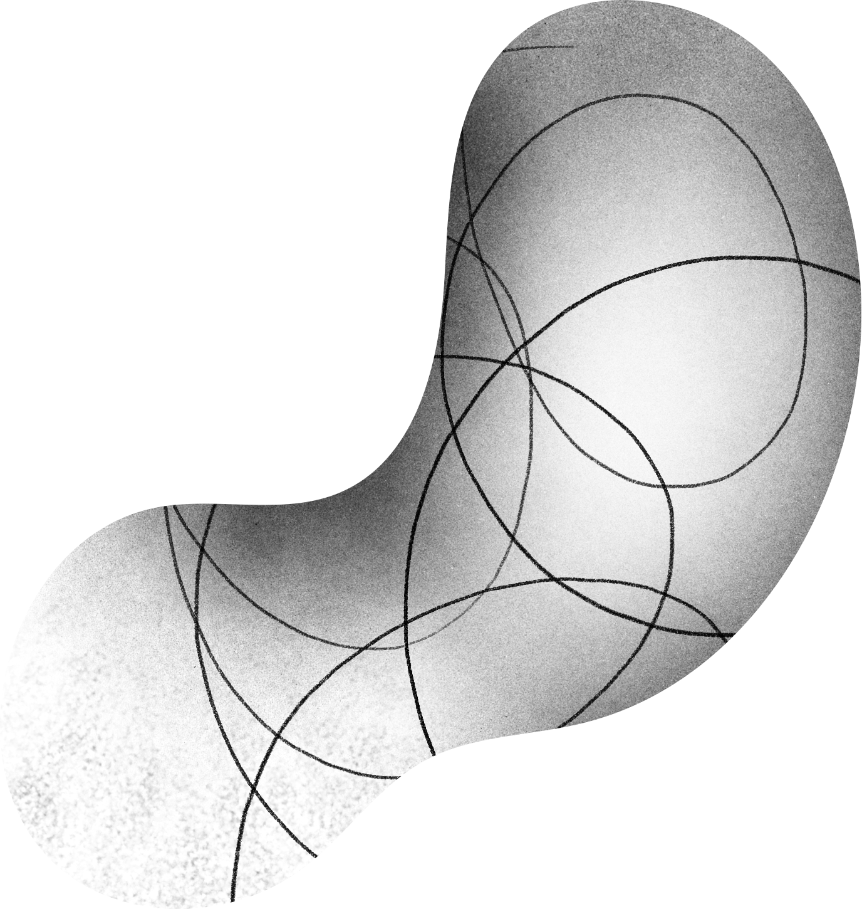
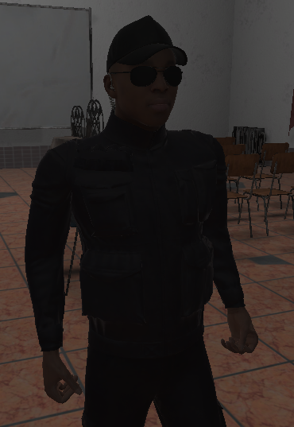
Objectives
IN "KARLHEINZ ASYLUM," YOUR SOLE AIM IS SURVIVAL. AS A CAPTIVE WITHIN THE OMINOUS ASYLUM'S CONFINES, YOU MUST ENDURE THE UNENDING ONSLAUGHT OF RAVENOUS ZOMBIES, RELYING ON YOUR CUNNING AND AVAILABLE RESOURCES TO OUTLAST THE NIGHTMARISH ORDEAL AND UNEARTH THE ASYLUM'S CHILLING SECRETS. THE ONLY THINGS THAT MATTER IS STAYING ALIVE AND KILLING ZOMBIES.
MAIN OBJECTIVES:
PLAYER MOVEMENT AND COMBAT
ENEMY AI AND COMBAT
WEAPON SYSTEM IMPLEMENTATION

Slide 5
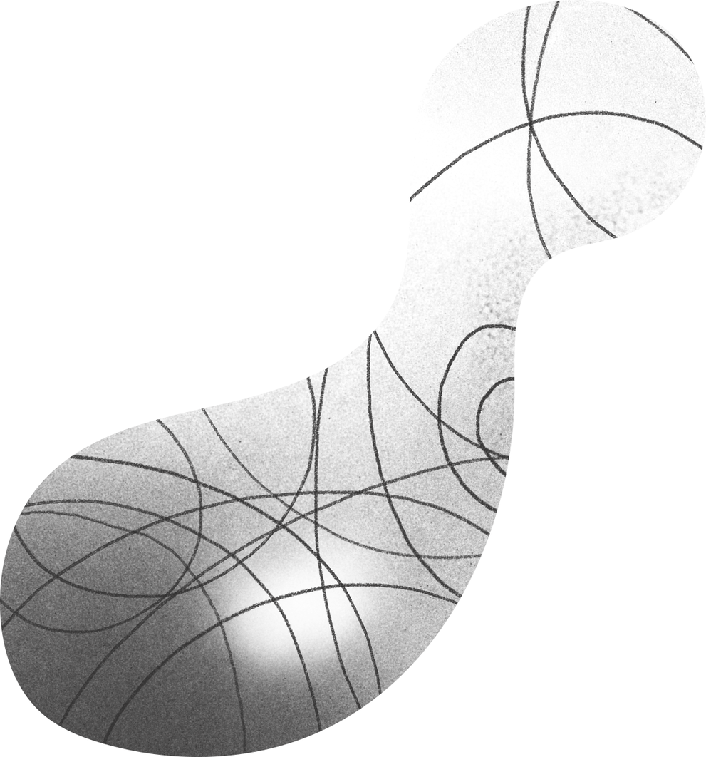


Scripts Created
PICK RIFLE
HEATH BAR
ZOMBIE AI
END MENU
PLAYER HEALTH
SHOOTER
WAVE
GUN SYSTEM
THIRD PERSON MOVEMENT
MENUS
WAVE SPAWNER
GUN
ENEMY ATTACK, IDLE, PATROL AND CHASE STATE.
PLAYER PUNCH
MAIN MENU
TARGET

Slide 6
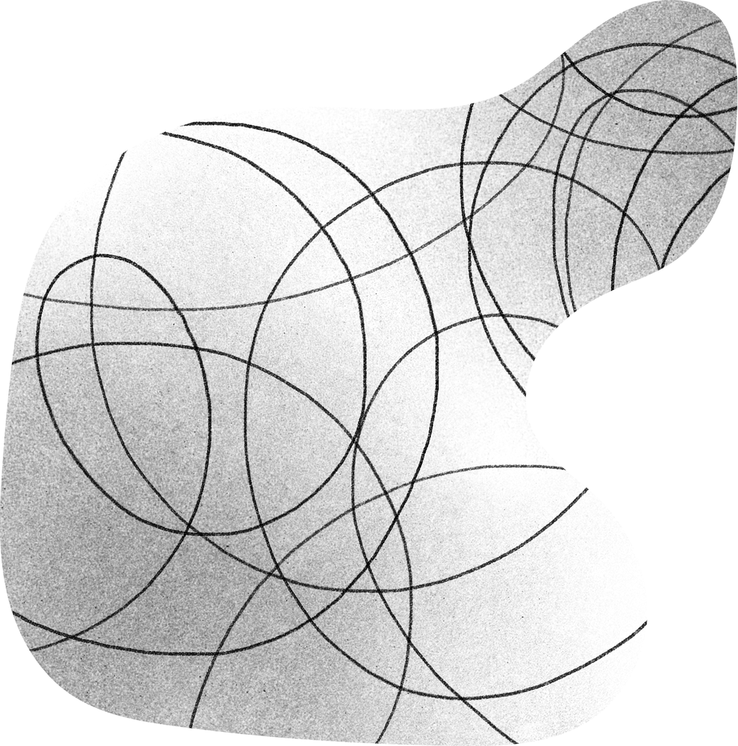
FEATURES
Wave Spawning after a fixed interval of time.
Player Movement and Enemies State System.
Ammo Box Collection System.
Different camera POV for aiming.
Weapon System implementation.
Enemy AI Implementation.

Slide 7
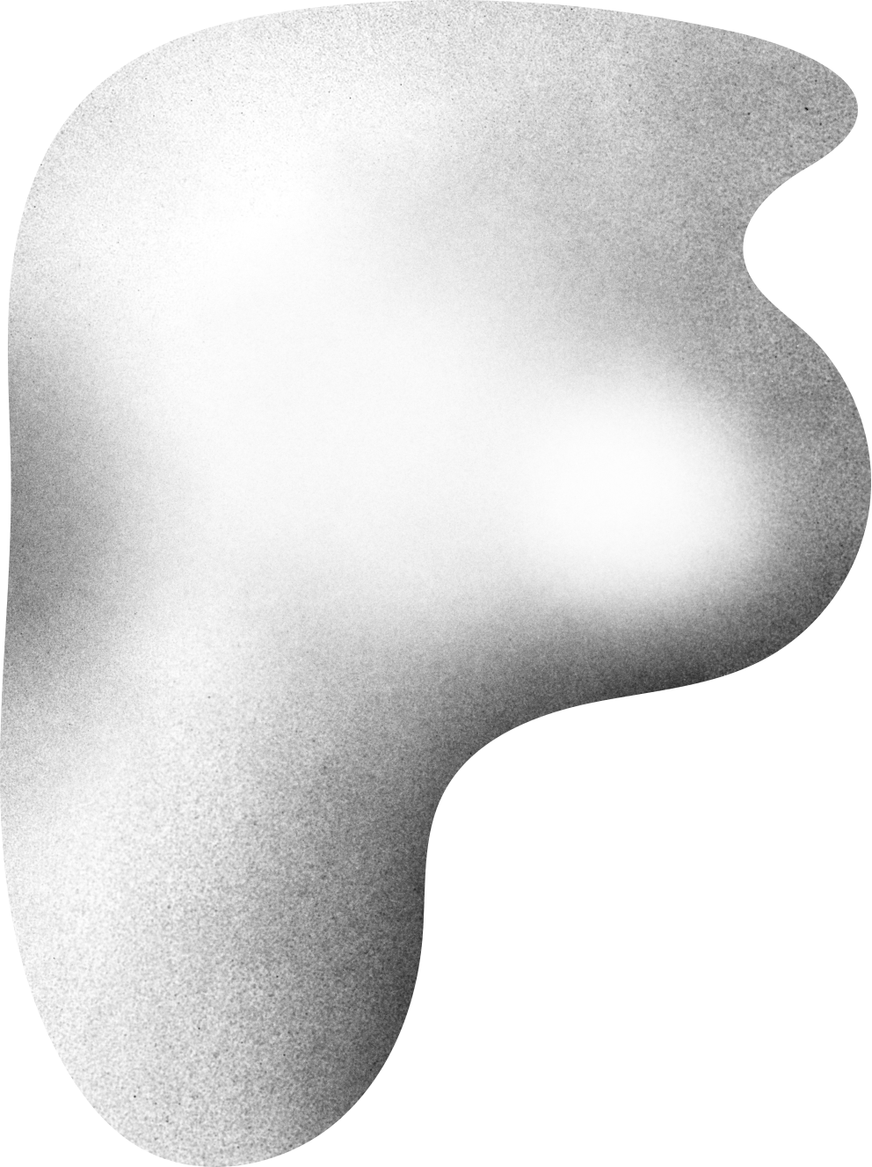
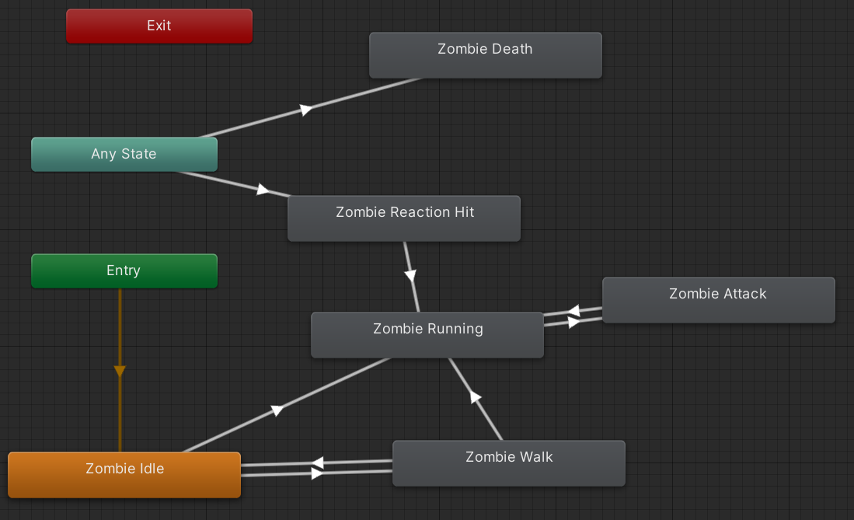
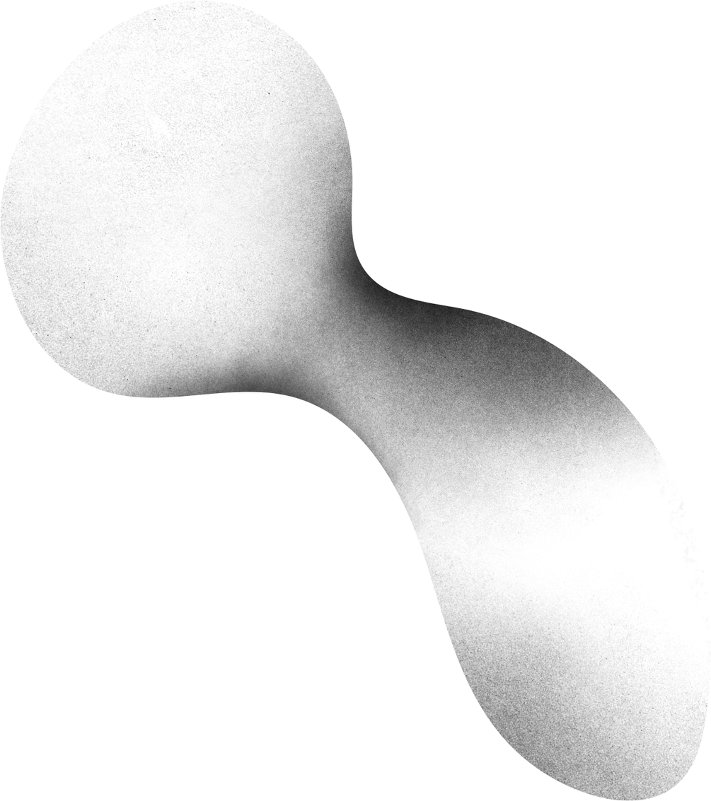
STATE MACHINE CHART

Slide 8
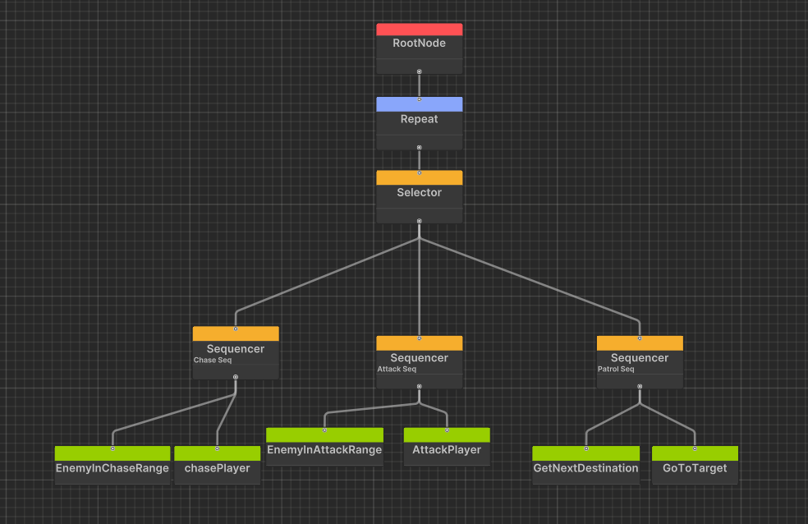
Behaviour TREE

Slide 9
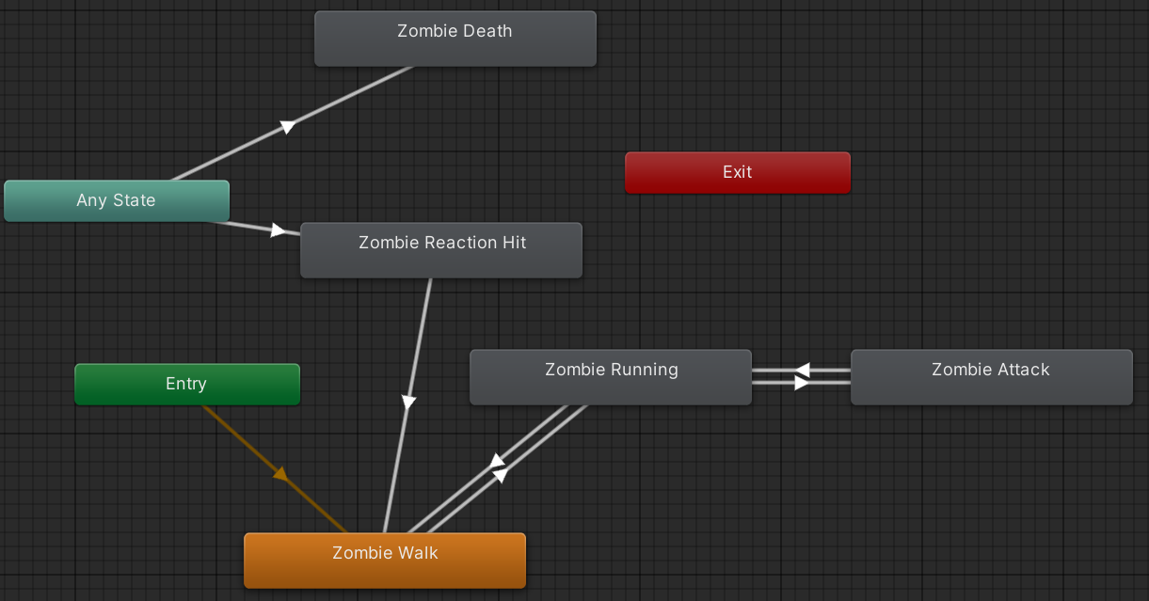
Behaviour TREE Animation Chart

Slide 10
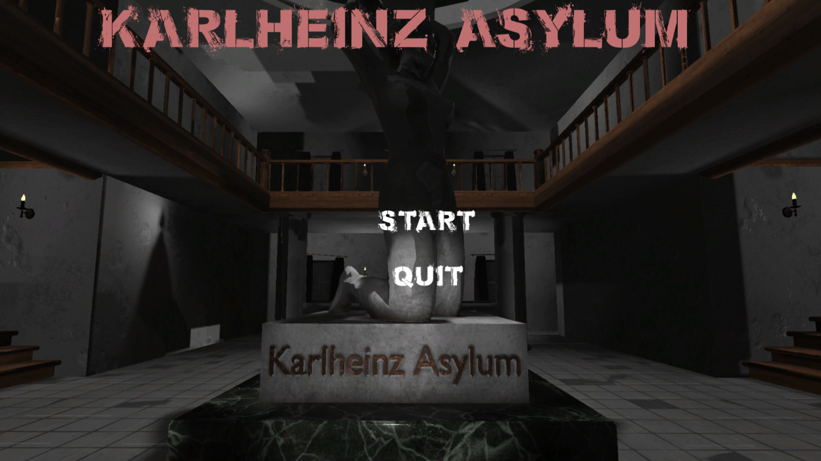
Main Menu

Slide 11
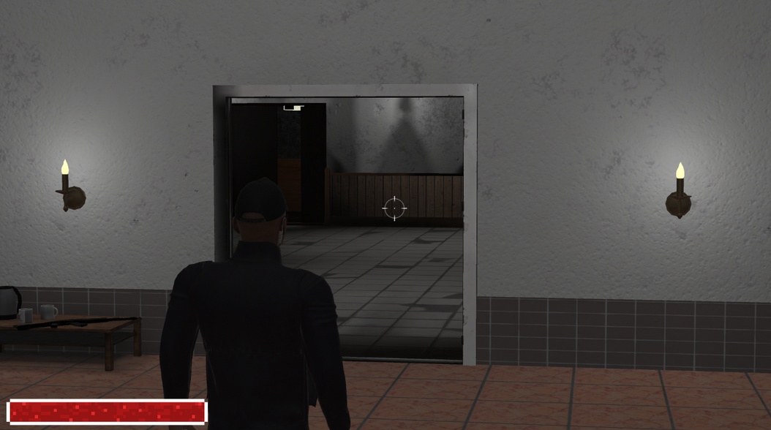
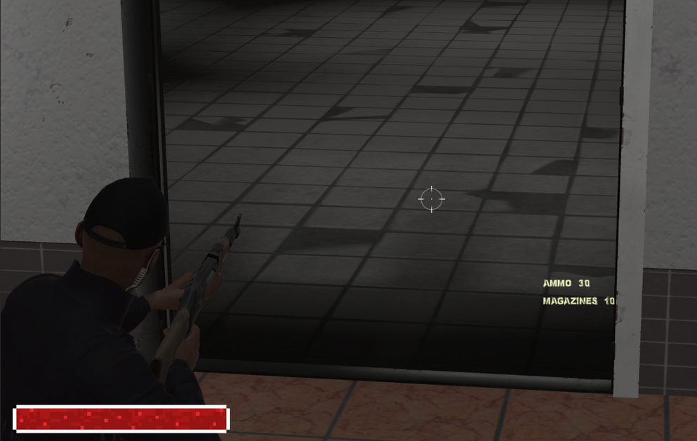
IN GAME

Slide 12
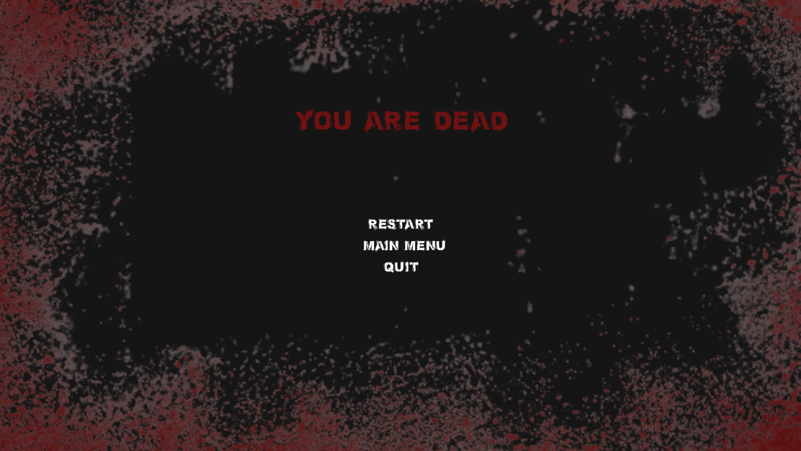
End Menu

Slide 13
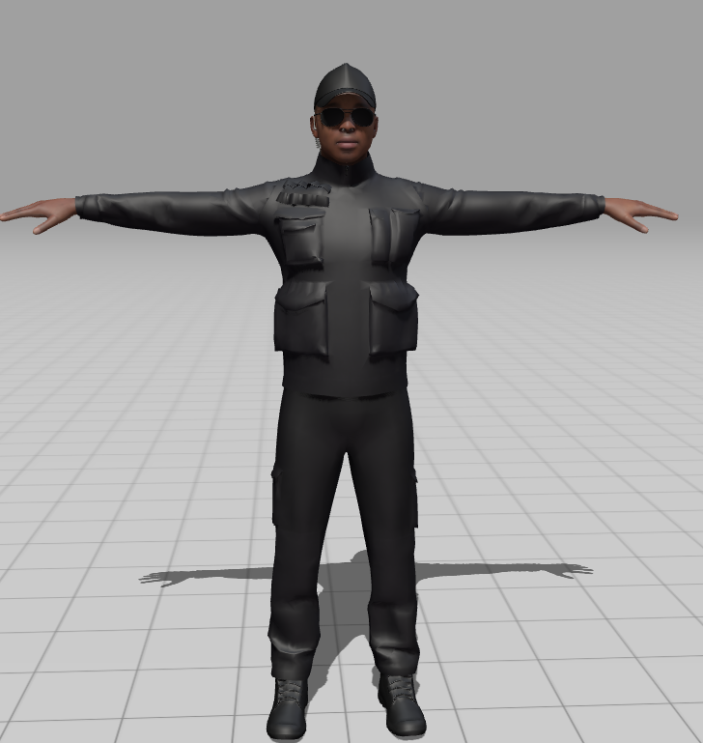
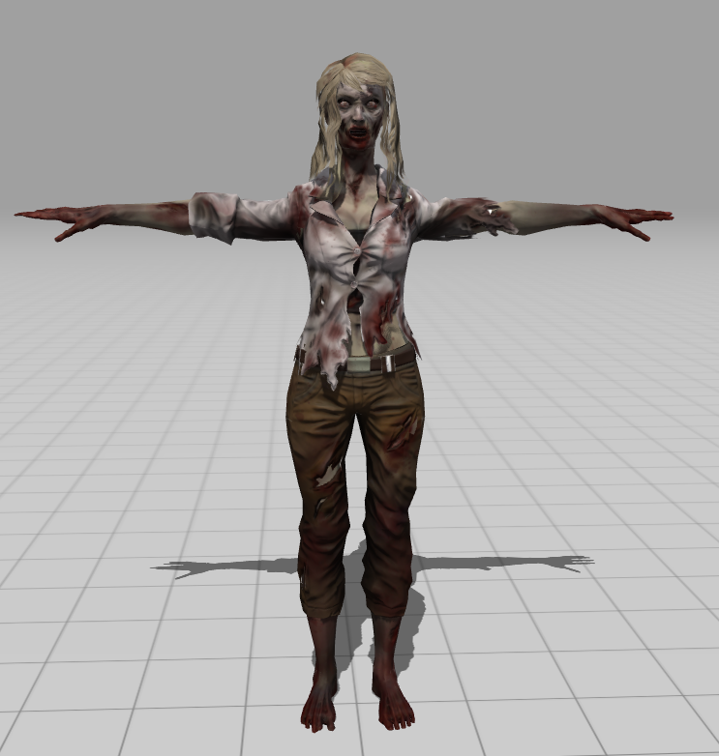
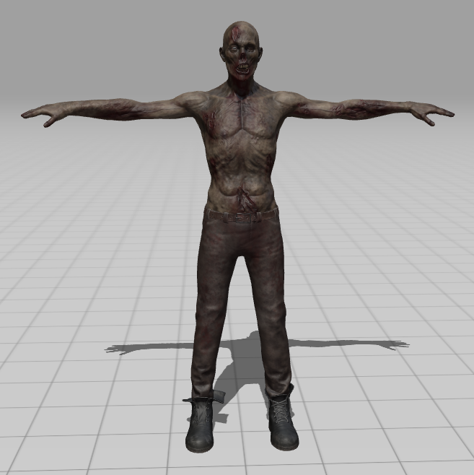
Player
Enemy

Slide 14
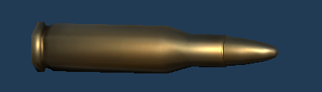
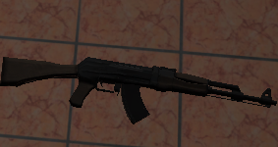
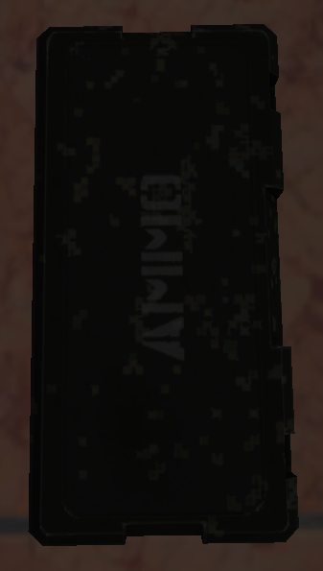
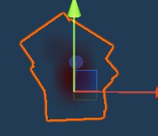

ASSET USED

Slide 15
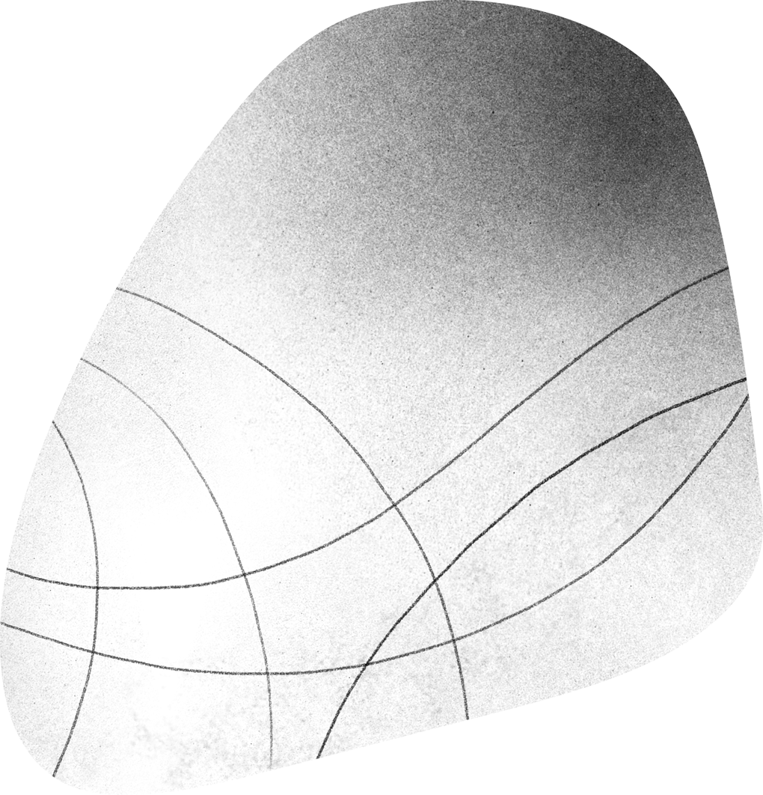
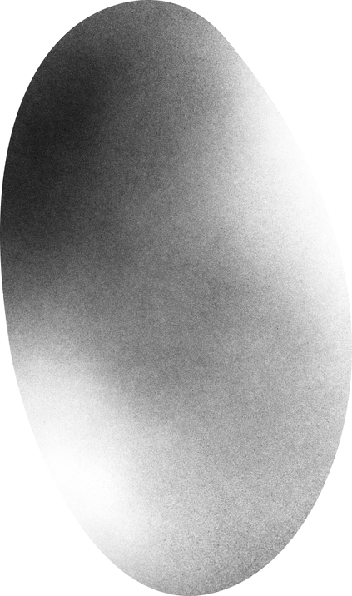
References
YOUTUBE
UNITY
OUTER REFERENCES
LEARNED NAVMESH
LEARNED WAYPOINTS
LEARNED STATE MACHINE
LEARNED WEAPON SYSTEM IMPLEMENTATION.
UNITY DOCUMENTATION.
UNTY ASSET STORE
UNITY AI NAVIGATION SYSYTEM.
UNITY STANDARD PARTICLE SYSTEM PACK.
USED MIXAMO FOR CHARACTER MODELS OF ENEMY AND PLAYER.

Slide 16
PROBLEMS FACED
Execution of the health bar in game.
Trouble making player combat and enemies health.
Bugs caused by box colliders.
Unity crashing problem.
Weapon System implementation.
Enemy AI Implementation.
NavMesh Implementatioon.

Slide 17


